Slide 1

MANAGEMENT SCIENCE AND FINANCIAL ACCOUNTING
UNIT- I
INTRODUCTION TO MANAGEMENT

Slide 2
CONTENTS
Management – Definitions
Levels of Management
Functions of Management
Planning – Types of planning
Planning process
Organizing – Organizational design and structure
Staffing
Directing
Controlling – Basic Control process
Fayol’s principles of Management
Taylor’s Scientific Management
Maslow’s Motivational theory

Slide 3
DEFINITION
Management is the attainment of organizational goals in an effective and efficient manner through planning, organizing, staffing, directing and controlling organizational resources.
Organizational resources include men (human beings), money, machines and materials.

Slide 4
FEW MORE DEFINITIONS
Louis E Boone & David L Kurtz - The use of people and other resources to accomplish objectives.
Mary Parker Follet - The act of getting things done through people.
Frederick Taylor – Management is ‘the art of knowing what you want to do and doing it in the best and cheapest way’.

Slide 5
CHARACTERISTICS
Management is a distinct process.
Management is an organized activity.
Management aims at the accomplishment of predetermined objectives.
Management is both a science and an art.
Management is a group activity.
Management principles are universal in nature
Management integrates human and other resources.

Slide 6
LEVELS OF MANAGEMENT
The term “Levels of Management’ refers to a line of demarcation between various managerial positions in an organization.
The level of management determines a chain of command, the amount of authority & status enjoyed by any managerial position.

Slide 7
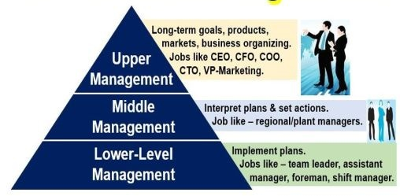

Slide 8
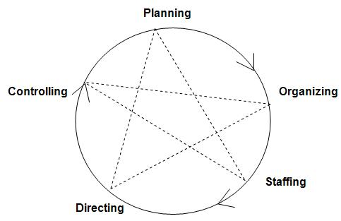
FUNCTIONS OF MANAGEMENT

Slide 9
PLANNING
Planning is determining the objectives and formulating the methods to achieve them. It is the most fundamental function of management.
“Planning is deciding in advance what is to be done in future. Plan bridges the gap between where we are & where we want to go” - Harold Koontz

Slide 10
It is the basic process of setting up goals to be reached and course of action to be followed.
It is in fact a prerequisite to effective management.
Planning is the management function of anticipating the future and the conscious determination of a future course of action to achieve the desired results.
A plan is a predetermined course of action to be followed in future.

Slide 11
Types of Plans
A manager is required to develop a number of plans to achieve the organizational objectives.
TYPES OF PLANS
Operational
Tactical
Strategic
Contingency
Single use plans
Budget
Programme
Continuing Plans
Policy
Procedures
Rules

Slide 12
1.Operational Plans:
Operational goals are the specific goals that focus on the results expected from the departments, work groups and individuals. Operational plans may be single use plans or ongoing plans.
a. Single use plans: It is applied to those activities which do not recur or repeat.

Slide 13
(i) Budget: It is a statement of expected results expressed in quantitative terms for a definite period of time.
(ii) Programme: It is a sequence of activities to be undertaken for implementing the policies and achieving the objectives of an organization.

Slide 14
b. Continuing or ongoing plans: These are usually made once and retain their value over a period of years while undergoing periodic revision and updates.
(i) Policy: It provides broad guidelines for managers to follow when dealing with important areas of decision making.

Slide 15
(ii) Procedures: A procedure is a set of step by step direction that explains how activities or task are to be carried out.
(iii) Rules: It is an explicit statement that tells an employee, what he or she can and cannot do.

Slide 16
2. Tactical Plans: These are plans which usually span for a period of one year or less.
It is concerned with what the lower level units within each division must do, how they must do it, and who is in-charge at each level.
Tactics are the means needed to activate a strategy and make it work.

Slide 17
3. Strategic Plan: It is an outline of steps designed with the goals of the entire organization in mind, rather than with the goals of specific divisions.
It looks ahead over five or even more years to move the organization from where it currently is to where it wants to be.
4.Contingency Plan: These plans are used when the original plan proves inadequate because of changing circumstances.

Slide 18
PLANNING PROCESS
It is not necessary that a particular planning process is applicable for all the organizations and for all types of plans because the various factors that go into planning process may differ from plan to plan or from one organization to another.

Slide 19
Planning Process Diagram
Perception of opportunities
Establishing objectives
Planning
premises
Identification of Policies
Establishing sequence of activities
Formulation of supporting plans
Selection of alternatives
Evaluation of alternatives

Slide 20
ORGANIZING
The process by which managers establish working relationships among employees to achieve goals is called Organizing.
According to Chester Barnard, Organization is defined as “A system of consciously coordinated activities or efforts of two or more persons”.

Slide 21
An Organization is defined as a deliberate arrangement of people to accomplish some specific purpose.
Process
a course of action, a route, a progression
Structure
an arrangement, a configuration, a construction

Slide 22
The process of organizing takes place within a structure reflected by the way in which the organization
Divides its labor into departments and jobs.
Establishes formal lines of authority.
Establishes mechanisms for coordinating diverse tasks.

Slide 23
ORGANIZATIONAL DESIGN & STRUCTURES
Organizing process leads to creation of an Organizational Structure
Formal tasks assigned
Formal reporting relationships
Systems design for coordination across departments

Slide 24
LINE ORGANIZATION
Line Organization structure is also known as scalar, military or vertical organization and perhaps is the oldest form.
This concept holds that in any organization, hierarchy is derived from a scalar process. There must be a single head who commands it.

Slide 25
Line Organization can be designed in two ways:
Pure Line Organization: Similar activities are performed at a particular level.
Departmental Line Organization: Entire activities are divided into different departments on the basis of similarity of activities.
Chief Executive
Chief Executive
FOREMAN A
FOREMAN B
FOREMAN C
Workers
Workers
Workers

Slide 26
LINE AND STAFF ORGANIZATION
It refers to a pattern in which staff specialists advise line managers to perform their duties.
The problem can usually be solved by classifying activities within an organization in two ways:
That which is substantive (direct) in its contribution – Line activities
That which is objective (indirect) in its contribution – Staff activities

Slide 27
LINE AND STAFF ORGANIZATION
GENERAL MANAGER
advisor
Manager (Finance)
Manager (personnel)
Manager - Production
Manager - Marketing
Production Engineer
Production Engineer
Workers
Workers

Slide 28
OTHER TYPES OF ORGANIZATIONAL STRUCTURES
Functional Organizational Structure
Committee Organization
Matrix Organization
Virtual Organization
Cellular Organization
Team Structure

Slide 29
Functional Organizational Structure
A functional structure divides the organization into departments based on their function. Each is headed by a functional manager and employees are grouped as per their role.
Or
A functional organization is a common type of organizational structure in which the organization is divided into smaller groups based on specialized functional areas, such as IT, finance, or marketing.

Slide 30
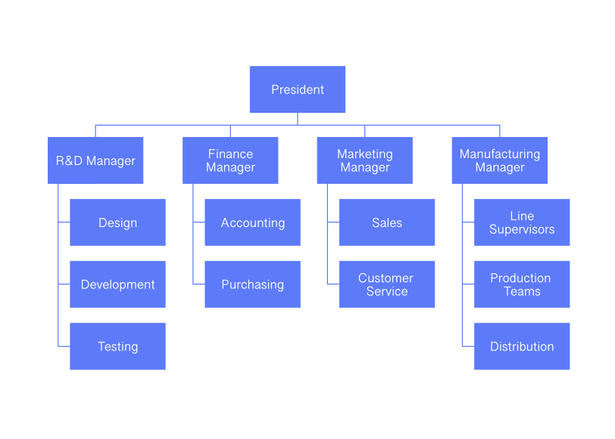

Slide 31
Committee Organization
It can be defined as a body of persons appointed to meet on an organized basis for the discussion and dealing of matters brought before it.
FEATURES:
Group of persons
Can deliberate only on matters that are brought before it
Members of the committee draw authority through delegation.

Slide 32
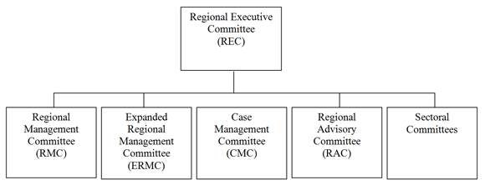

Slide 33
MATRIX ORGANIZATION
Matrix Organization is the realization of two dimensional structure which emanates directly from two dimensions of authority.

Slide 34
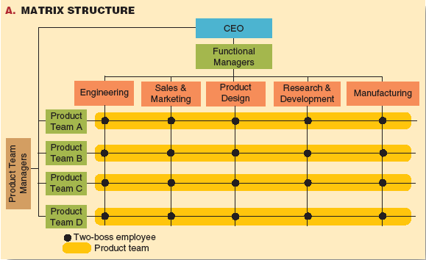

Slide 35
Virtual Organization
Virtual Organization is a temporary network of independent companies – suppliers, customers, even erstwhile rivals – linked by information technology to share skills, costs and access to one another’s markets.
It will have neither central office nor organization chart. It will have no hierarchy, no vertical integration.

Slide 36
Virtual Organizational Structure
Product Development Firm (France)
Marketing Firm (U.K.)
Core Firm (Canada)
Customer Service Firm (U.S.A.)
Production Firm (China)
Accounting Firm (Canada)

Slide 37
CELLULAR ORGANIZATION
It is a form of organization consisting of a collection of self-managing firms or cells held together by mutual interest.
A cellular organization is built on the principles of self-organization, member ownership, and entrepreneurship.
Each cell within the organization shares common information and purposes with its sister cells but is also able to function independently.

Slide 38
Parent institution
Cell 1
Cell 3
Cell 2

Slide 39
TEAM STRUCTURE
A Team is a group of people in the organization constituted for completing certain assignments.

Slide 40
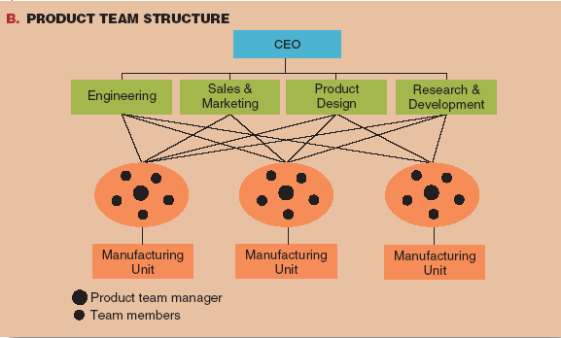

Slide 41
STAFFING
Staffing pertains to recruitment, selection, development and compensation of subordinates
It is the process involved in identifying, assessing, placing, evaluating, and directing individuals at work place.
Staffing function involves Man power planning, Recruitment, Selection, Training and Development and Performance Appraisal.

Slide 42
DIRECTING
Directing consists of the process and techniques utilized in issuing instructions and making certain that operations are carried on as originally planned
1.Provides positive and dynamic leadership.
2.Provides maximum opportunities.
3.Provides proper motivation of personnel.
4.Ability to command people.

Slide 43
CONTROLLING
Managers monitor and regulate how efficiently and effectively an organization and its members are performing the activities necessary to achieve organizational goals

Slide 44
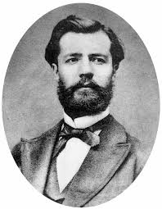
Fayol’s Principles of Management
There are 14 Principles of Management described by Henry Fayol
1. Division of Labor | 8. Initiative
2. Authority & Responsibility | 9. Fair Remuneration
3. Principle of One Boss | 10. Stability of Tenure
4. Unity of Direction | 11. Scalar Chain
5. Equity | 12. Sub-Ordination of Individual Interest to General Interest
6. Order | 13. Espirit De’ Corps
7. Discipline | 14. Centralization & De-Centralization

Slide 45
Taylor’s Principles of Scientific Management:
Fredrick Winslow Taylor commonly known as ‘Father of Scientific Management’. He was an
American mechanical engineer who sought to improve industrial efficiency. He was one of the first management consultants.
According to Taylor, “Scientific Management is an art of knowing exactly what you want your men to do and seeing that they do it in the best and cheapest way”.

Slide 46
The Scientific Principles
I – Science, not Rule of Thumb
Taylor maintained that the rule of thumb should be replaced by scientific knowledge. While rule of thumb emphasizes mere estimation, scientific method denotes precision in determining any aspect of work. This should be done with the help of careful scientific investigation.

Slide 47
II – Harmony, not discord
Taylor emphasized that harmony rather than discord should be obtained in group action.
Harmony means that a group should work as a unit and contribute to the maximum.
Within it there should be mutual give and take situation and proper understanding.

Slide 48
III - Cooperation, not individualism
Scientific management requires that parts of industrial body co- operate with each other, scientific management is based on mutual confidence, co-operation and goodwill.
It requires a complete mental revolution on the part of both workers and management.

Slide 49
IV - The Development of each man to his greatest efficiency and prosperity.
In order to maximize production all possible efforts are made to increase the efficiency of workers.
Workers are selected according to the nature of work. It includes scientific training, scientific allotment of work, implementation of incentive wage plan above all, development of workers to the fullest extent for themselves and also for the companies highest prosperity

Slide 50
Maslow’s Motivational Theory:
Abraham Maslow between 1943-1954 developed his 'Hierarchy of needs' motivation theory.
His theory suggests that within each person their is a hierarchy of needs and the individual must satisfy each level before they move onto the next.
The behavior of an individual at a particular moment is usually determined by his strongest need.

Slide 51
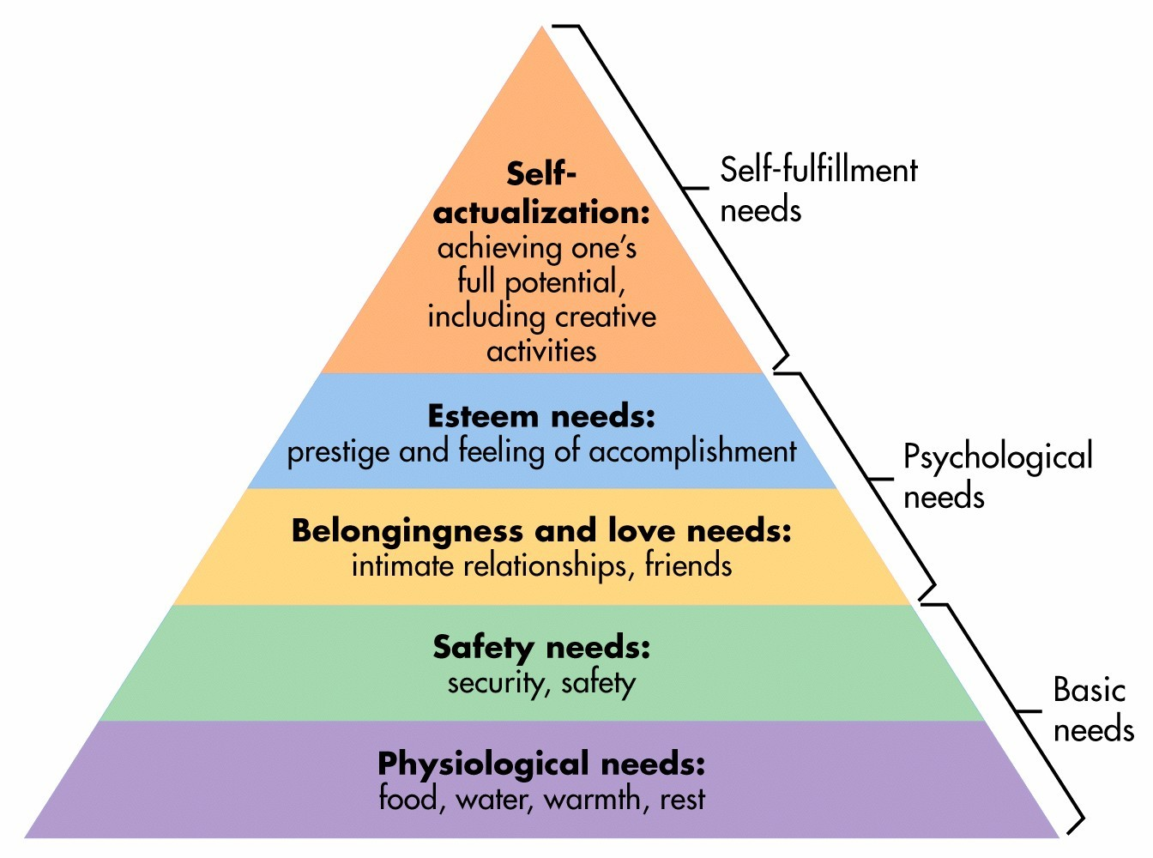

Slide 52
There are five hierarchical levels. These are:
Physiological Needs: Food, shelter, i.e. those needs needed for basic survival.
Safety Needs: The need to feel safe within your environment. Also refers to emotional and physical safety.
Social Needs: The need for love, friendship and belongingness

Slide 53
Esteem Needs: The need for self respect, status and recognition from others.
Self actualization: The point of reaching ones full potential. Are you capable at excelling yourself?

Slide 54
END

